Slide 1

Youtube Trending Category Classification
By:
Kyle Thao

Slide 2
Problem and Motivation
Youtube content creators
Classifying different trending videos
Understanding YouTube’s algorithm

Slide 3
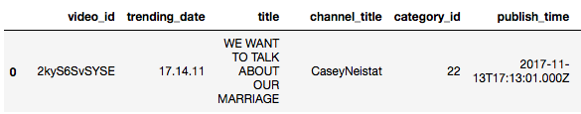
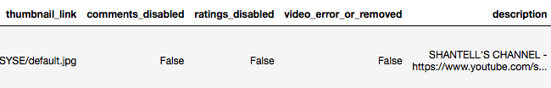
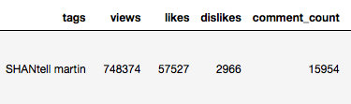
Dataset
[1]

Slide 4
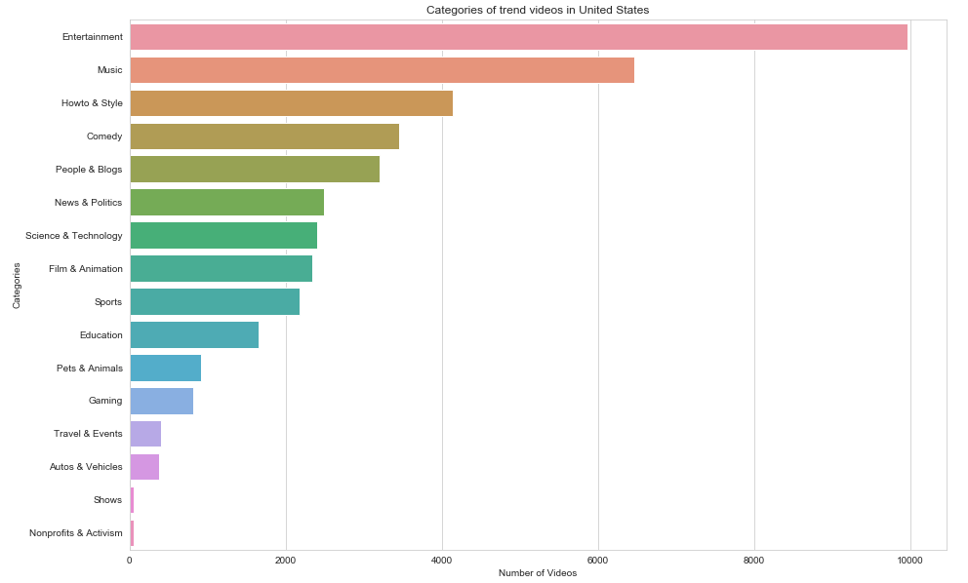

Slide 5

Encoding and Data Processing
Tags data before Normalization and processing:
Tags data after Normalization and processing:

Slide 6

Encoding and Data Processing
Used TF-IDF vectorizer with different parameters:
Max features: 50
Min features: 5

Slide 7

Encoding and Data Processing
Tried using a TF-IDF vectorizer with larger parameters:
Max features: 100
Min features: 2

Slide 8
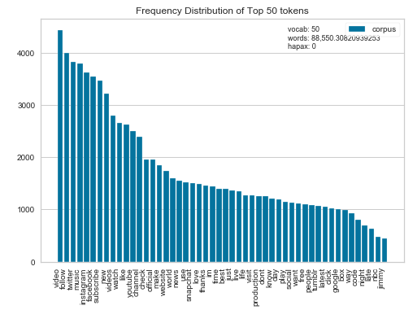
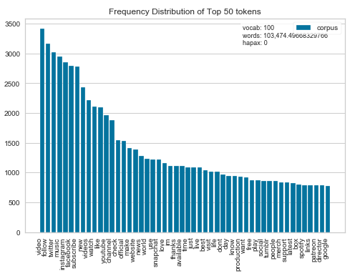
Encoding and Data Processing

Slide 9
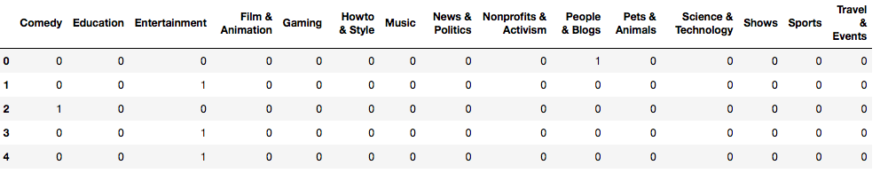
Encoding and Data Processing
One-hot encoding the categorical data

Slide 10
Models
Models I used included:
Fully Connected Neural Network
1D Convolutional Neural Network

Slide 11
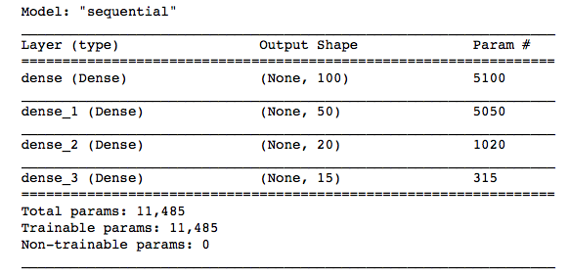
Fully Connected Neural Network Model

Slide 12
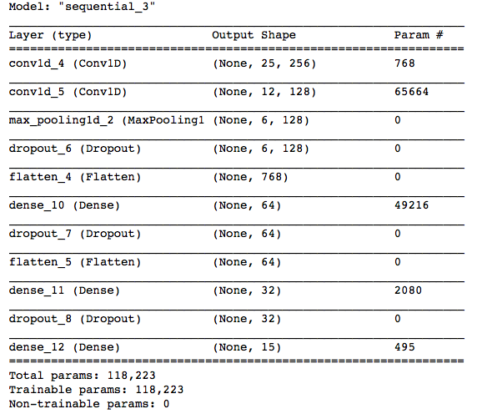
1D Convolutional Neural Network Model

Slide 13
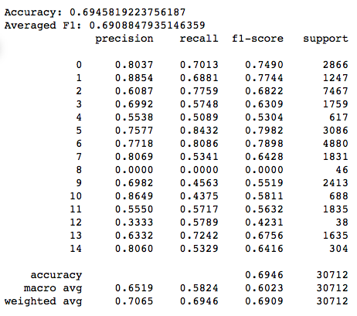
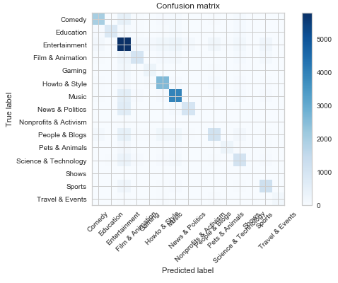
Results: Fully Connected Model
Accuracy: About 69%

Slide 14
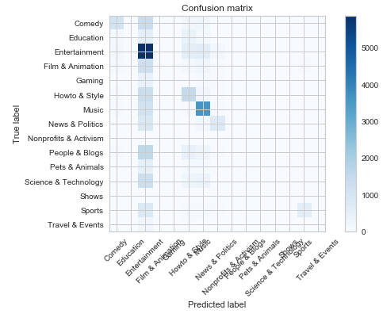

Results: 1D Convolutional Model
Accuracy: About 43%

Slide 15
Compared to Related Works:Mohit’s US Youtube EDA & Category Predictions
Used other models such as:
kNN
kNN with decision trees
Decision trees
Tuned decision trees
Random forest
Used different metrics like numerical data to classify categories

Slide 16
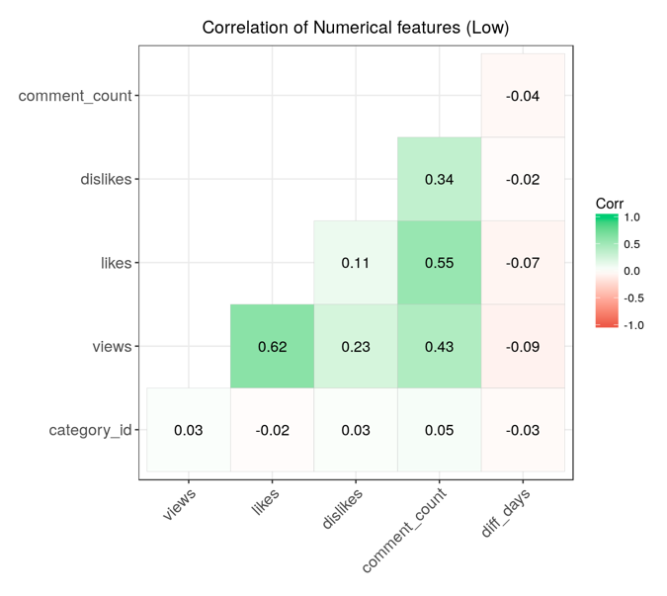
Mohit’s Correlation Graph
[2]

Slide 17
Mohit’s Results vs Mine
Mohit’s models averaged about 40-45% accuracy
My CNN model reached about the same accuracy with 43%
Fully Connected model reached higher at 69%

Slide 18
Conclusion:
Which model did better?
Fully Connected in all areas
Changes for next time?
Tweak CNN to possibly gain higher accuracies
Tweak the TF-IDF to filter other words
Use other region datasets
More models and metrics to compare

Slide 19
References
[1] Mitchell J. ”Trending YouTube Statistics“ https://www.kaggle.com/datasnack/youtube-new(2019)
[2]Mohit Bansal“Us YouTube EDA & Category Predictions
https://www.kaggle.com/bansmohit/us-youtube-eda-category-predictions(2018)

